Slide 1

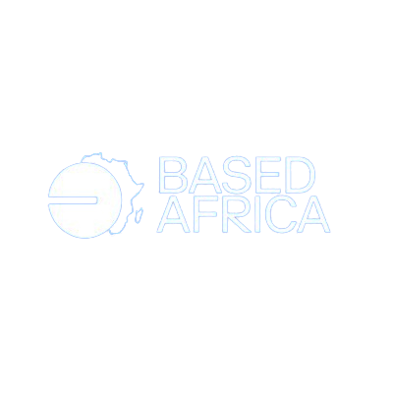
what
is
Web3?

Slide 2
the internet is always growing
and changing.
growing

Slide 3
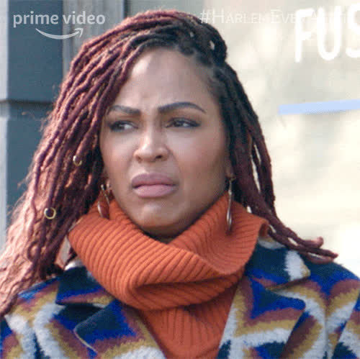

Slide 4
WEB 1

Slide 5
web1 was the first draft of the internet,
the one that was available in the 1990s
and early 2000s.

Slide 6
back then, people mostly
used the internet to
read web pages.

Slide 7
the web was mostly
made up of
static websites.

Slide 8
READ ONLY

Slide 9
WEB 2
WEB 2

Slide 10
web2 came about in the mid-2000s.
companies like facebook & twitter
empowered users to
create their own content.

Slide 11
unfortunately,
these companies monetized
user activity and data
by selling them to advertisers,
while retaining control over
their users data and activities.

Slide 12
READ AND WRITE

Slide 13
web3
web3
web3

Slide 14
web3 is a term used to describe the next* version of the internet.
an internet that is built on blockchain technology,
and is owned & controlled by its users.

Slide 15
both money and information are permissionless and open.

Slide 16
READ, WRITE and own

Slide 17
How is Web3 different from Web2?

Slide 18
in the web2 era, control over
transactions, content, and data
is centralized in tech corporations.

Slide 19
in web3 users have the power to
control their own information without
needing intermediaries.

Slide 20
web | architecture | examples
Web 1 | centralized | Netscape sina
Web 2 | centralized | facebook instagram
Web3 | distributed, decentralized | warpcast ens

Slide 21
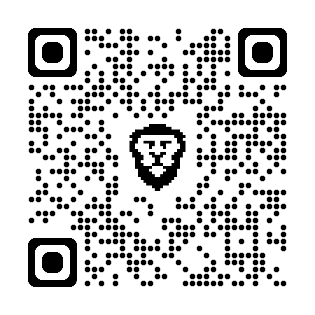
stay based
scan here
to learn more

